Slide 1

Data Definition

Slide 2

Wireframes for Data Definition
Req.-ID 0122 Define reporting obligations for a data collection

Slide 3
Management of Reporting Obligations
Main menu
My collections> STE > Reporting Obligation Definition
Add
Edit
Delete
Assign Modules
Export CSV
Reporting Obligation Definition
Navigation pane (Wizard)
Cycles
All
Not closed
Search
Cycle
Name
Cycle
Status
Reference Date
Remittance
Date
Entity Group
# of Modules
12
SI – Significant Banks
Not defined
In Preparation
10/05/2018
30/03/2018
!
12
LSI – Less Significant Banks
1
In Preparation
10/06/2018
30/03/2018
12
SI – Significant Banks Sub…
1
In Preparation
15/05/2018
30/03/2018
12
9
Started
30/06/2018
30/03/2018
LSI – Less Significant Banks Sub…

Slide 4

Management of Reporting Obligations
Main menu
My collections> STE > Reporting Obligation Definition
Add
Edit
Delete
View Reporting Obligations
Export CSV
Reporting Obligation Definition
Add Reporting Obligation
Only cycles in preparation based on the selected reference date
Tooltip: Group setting changed
Navigation pane (Wizard)
Cycle
Name
Cycle
Status
Reference Date
Remittance
Date
Entity Group
# of Modules
Element details
Collection details
Entity Group Version: 5
Reference Date
Reporting Cycle Name
Inactive until a reference date is entered
<
12
SI – Significant Banks
Not defined
In Preparation
10/05/2018
30/03/2018
!
12
Entity Group
LSI – Less Significant Banks
1
In Preparation
<
12
SI – Significant Banks Sub…
1
In Preparation
Remittance
10/06/2018
30/03/2018
12
Date
Offset
9
Started
LSI – Less Significant Banks Sub…
15/05/2018
30/03/2018
Remittance Date
Based on the selection either the date picker is displayed or the text field to enter the offset
30/06/2018
30/03/2018
Remittance Offset
Save
Cancel

Slide 5
Management of Reporting Obligations
Main menu
My collections> STE > Reporting Obligation Definition
Add
Edit
Delete
View Reporting Obligations
Export CSV
Reporting Obligation Definition
Edit Reporting Obligation
Tooltip: Group setting changed
Navigation pane (Wizard)
Cycle
Name
Cycle
Status
Reference Date
Remittance
Date
Entity Group
# of Modules
Element details
Collection details
Entity Group Version: 5
Reference Date
30/03/2018
Reporting Cycle Name
12
12
SI – Significant Banks
Not defined
In Preparation
10/05/2018
30/03/2018
!
12
LSI – Less Significant Banks
1
In Preparation
Entity Group
LSI – Less Significant …
12
SI – Significant Banks Sub…
1
In Preparation
Remittance
10/06/2018
30/03/2018
12
Date
Offset
9
Started
LSI – Less Significant Banks Sub…
15/05/2018
30/03/2018
Remittance Date
Based on the selection either the date picker is displayed or the text field to enter the offset
30/06/2018
30/03/2018
Remittance Offset
Save
Cancel

Slide 6
Management of Reporting Obligations
Main menu
My collections> STE > Reporting Obligation Definition
Add
Edit
Delete
View Reporting Obligations
Export CSV
Reporting Obligation Definition
Delete Reporting Obligation
Tooltip: Group setting changed
Navigation pane (Wizard)
Cycle
Name
Cycle
Status
Reference Date
Remittance
Date
Entity Group
# of Modules
Element details
Collection details
Entity Group Version: 5
Reference Date
30/03/2018
Reporting Cycle Name
12
12
SI – Significant Banks
Not defined
In Preparation
10/05/2018
30/03/2018
!
12
LSI – Less Significant Banks
1
In Preparation
Entity Group
LSI – Less Significant …
12
SI – Significant Banks Sub…
1
In Preparation
Remittance
10/06/2018
30/03/2018
12
Date
Offset
9
Started
LSI – Less Significant Banks Sub…
15/05/2018
30/03/2018
Remittance Date
15/04/2018
30/06/2018
30/03/2018
Data is shown before a final deletion.
Delete
Cancel

Slide 7
Management of Reporting Obligations
Main menu
My collections> STE > Reporting Obligation Definition
Add
Edit
Delete
View Reporting Obligations
Export CSV
Reporting Obligation Definition
Assign Module
Tooltip: Group setting changed
Navigation pane (Wizard)
Cycle
Name
Cycle
Status
Reference Date
Remittance
Date
Entity Group
# of Modules
Element details
Collection details
Entity Group Version: 5
Reference Date
30/03/2018
Reporting Cycle
12
12
In Preparation
12
Entity Group
LSI – Less Significant …
In Preparation
12
Valid versions based on module name and reference date; former versions can be selected
Optional or Expected
In Preparation
10/06/2018
12
30/03/2018
Not defined
10/05/2018
SI – Significant Banks
9
Started
30/03/2018
!
x
Credit Risk
5
LSI – Less Significant Banks Sub…
<
Expected
<
15/05/2018
30/03/2018
LSI – Less Significant Banks
1
Market Risk
3
Expected
30/06/2018
<
<
Evaluation if this table can be setup with ag grid
30/03/2018
SI – Significant Banks Sub…
1
x
Liquidity Risk
4
Expected
<
<
Save
Cancel

Slide 8
Management of Entity Groups
Main menu
Warning if user wants to leave w/o saving after selection
My collections> STE > Reporting Obligation Definition
Back
Save
Navigation pane (Wizard)
Reporting Cycle: 12 Entity Group: LSI – Less Significant Banks Subordinated Reference Date: 30/03/2018 Remittance Date: 15/04/2018
Assigned Modules
Module Code | Module Name | Version | Expected
Credit | Credit Risk | 5 | Expected
Liquidity | Liquidity Risk | 4 | Expected

Slide 9
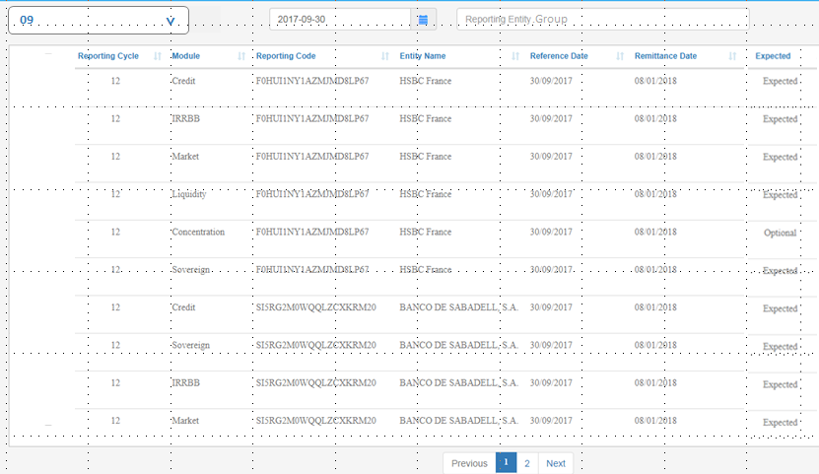
Management of Reporting Obligations
Main menu
My collections> STE > View Reporting Obligations
Back
Export CSV
X
View Reporting Obligations
Enable filtering on reporting cycles
Enable filtering on groups (including the “All” option)
12
LSI – Less Significant Banks Sub…
<

